Slide 1
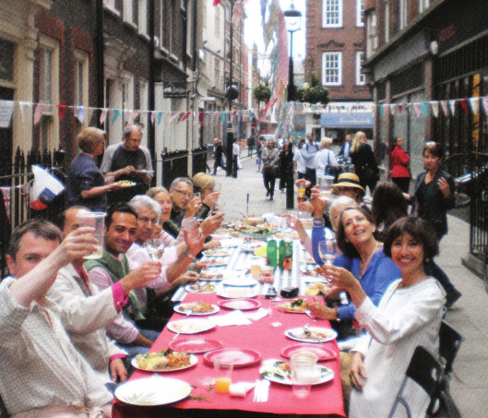
Do we want a community here?
Do we want a community of long-term residents in the Centre of London?
The West End is the driver of London’s commercial and economic success and lies at the heart of its cultural offer. It is also home to long-established and new communities, bringing family and neighbourhood life to the heart of London.
– West End Partnership Board Vision, June 2015.

Slide 2
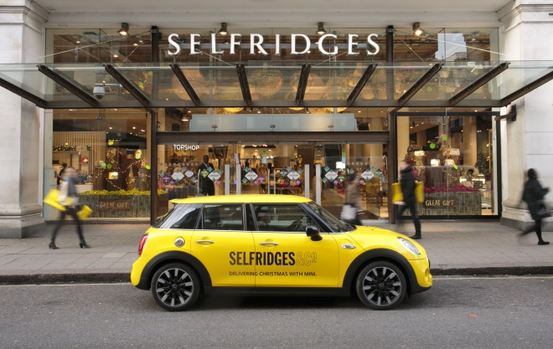
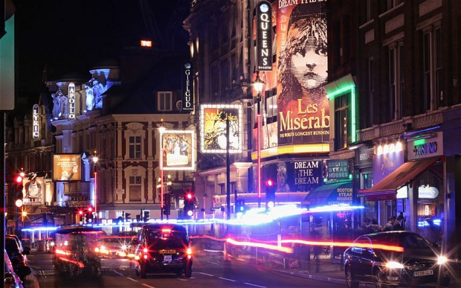
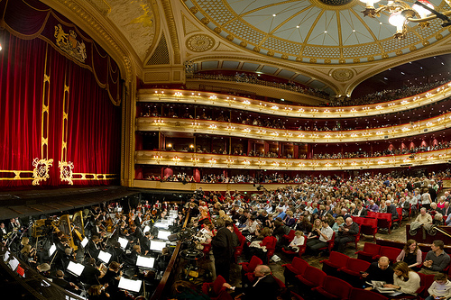
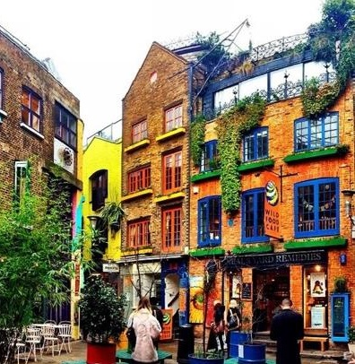
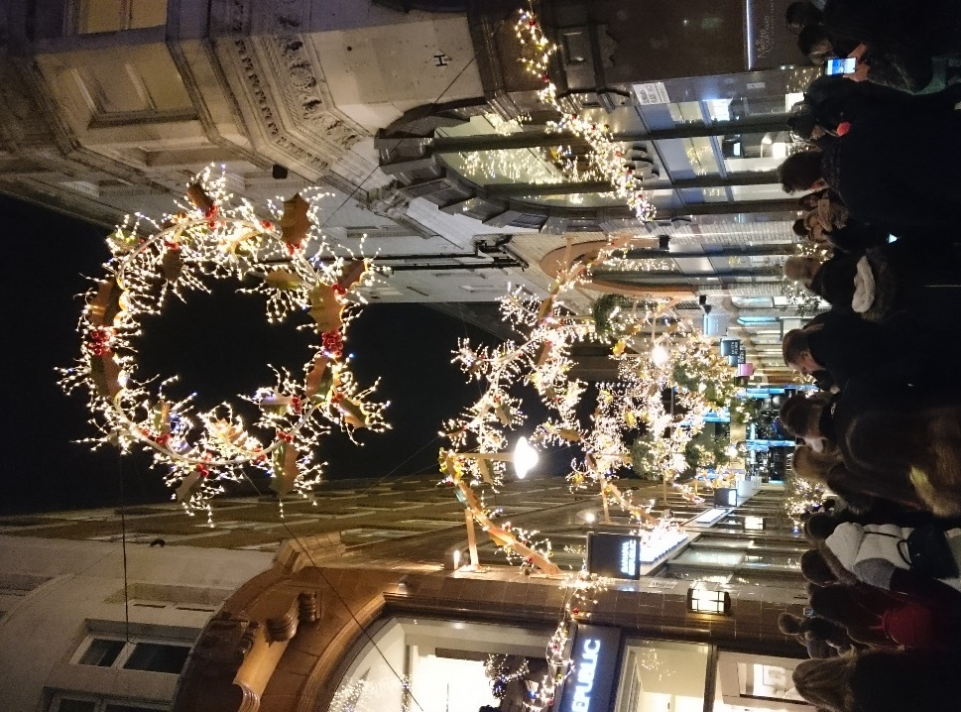

What is the West End?
What is the West End?

Slide 3
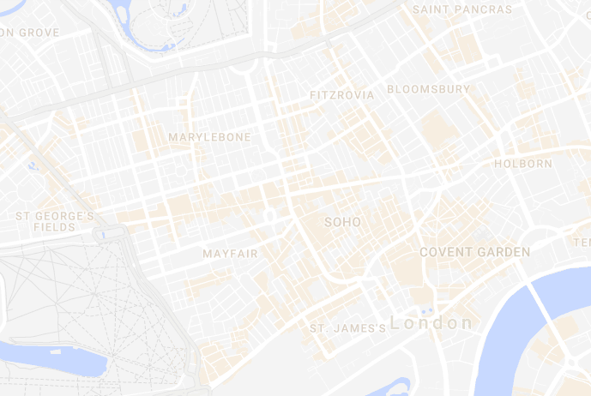
The West End is a series of villages
London’s West End..
..is a series of villages.
Soho
Covent Garden
Each with its own story.

Slide 4
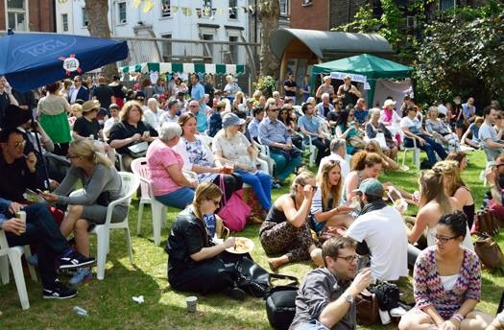
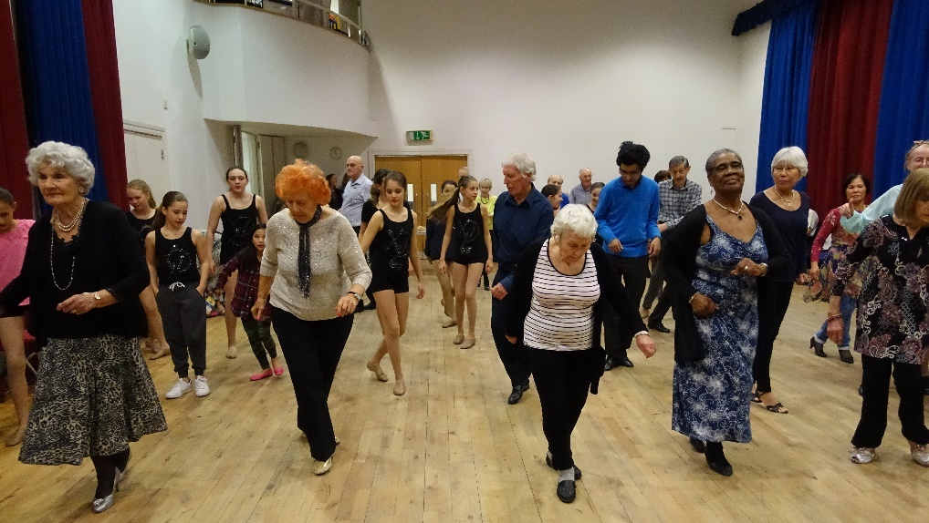
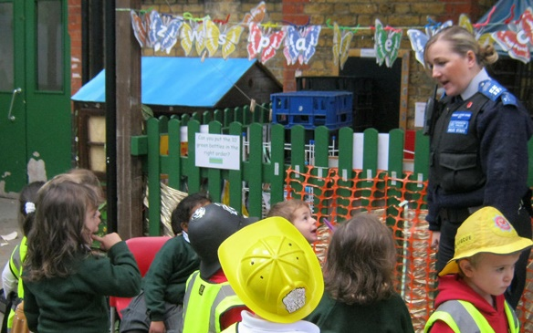
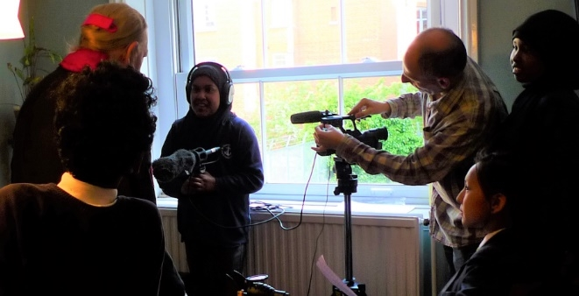
Community pictures
In each village there is a real sense of community.
We know our neighbours.
We look out for one another’s kids.
We try to help our elderly live full lives.
We fight many battles together.

Slide 5
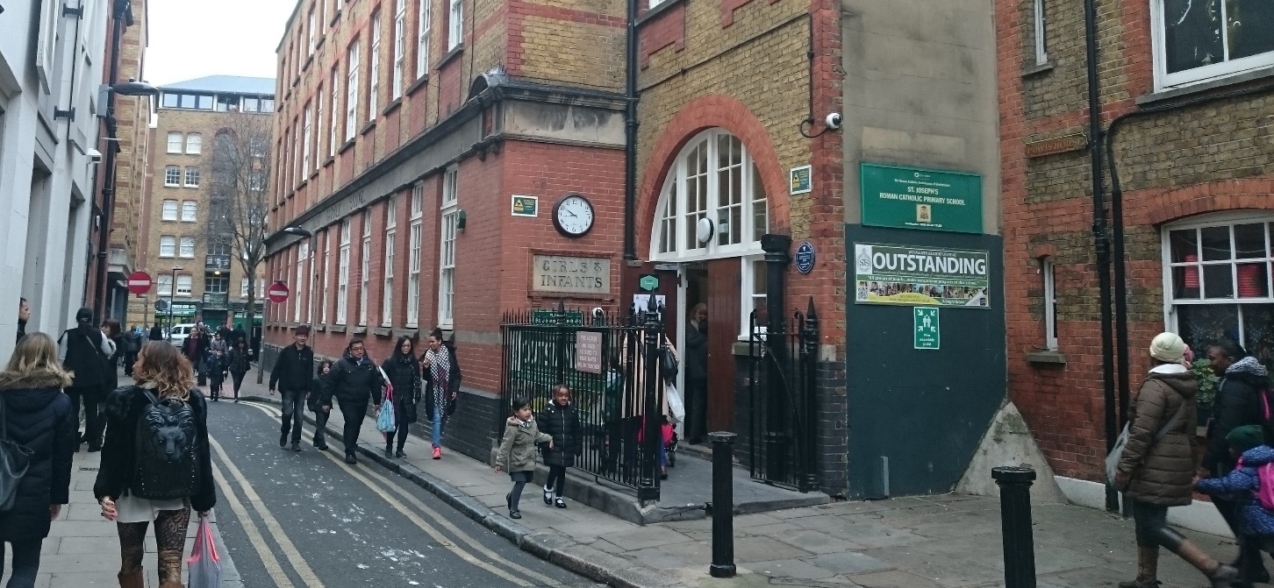
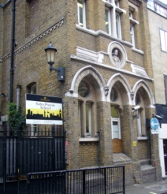
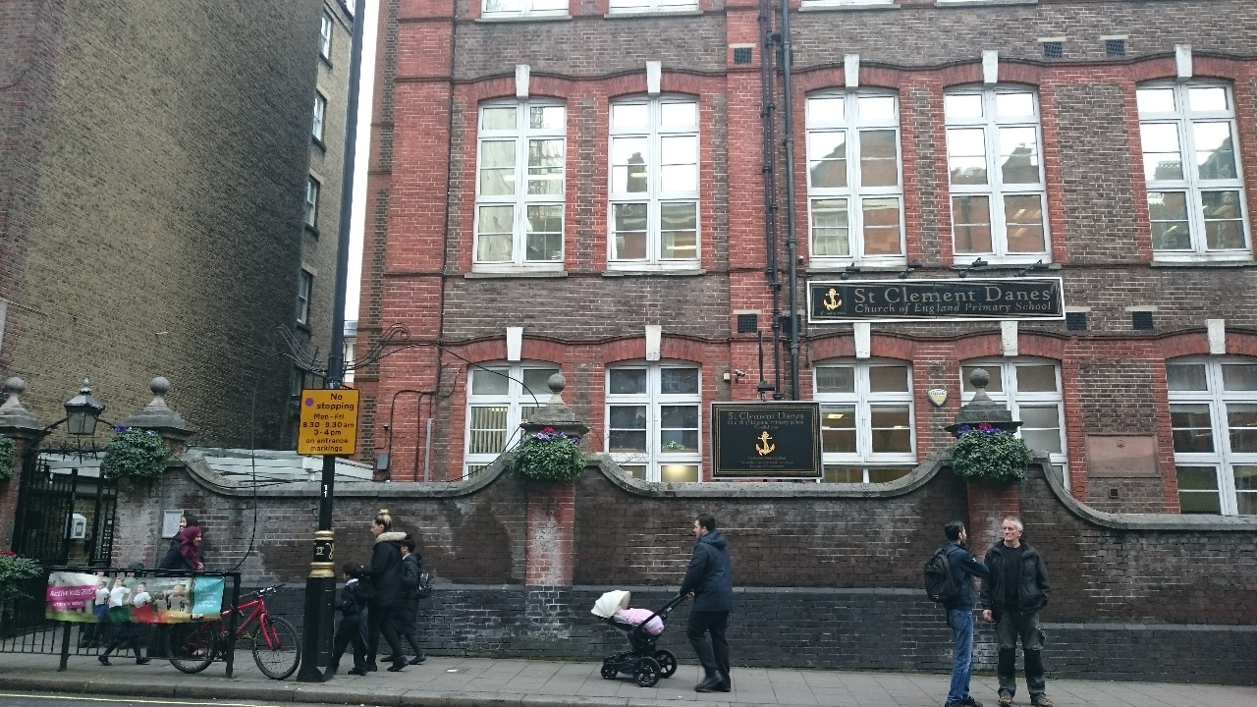
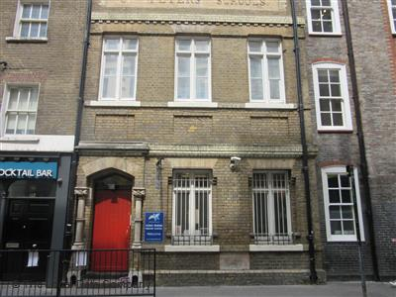
School pictures
There are still lots of families.

Slide 6
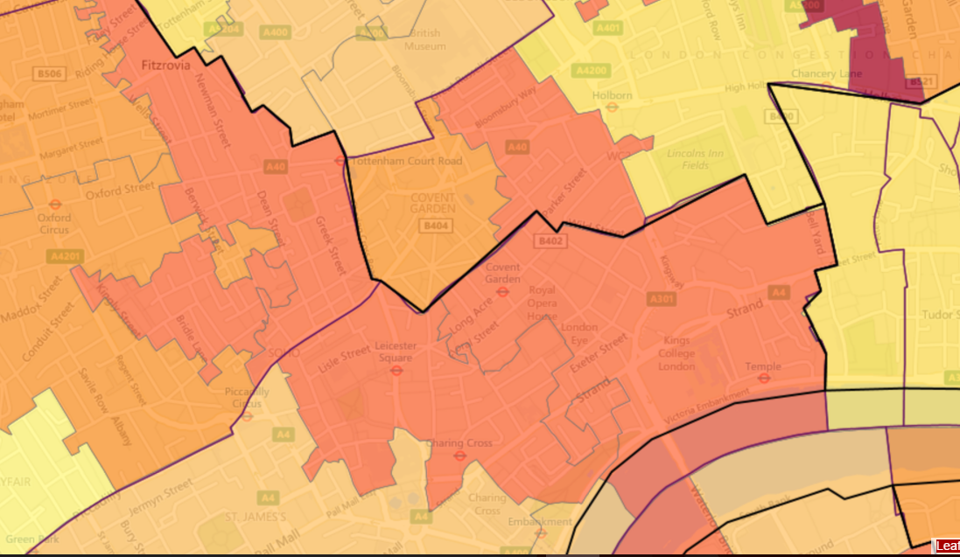

Challenges
But there are a lot of challenges…
Deprivation. Most of Covent Garden & Soho is in the 30% most deprived areas in the UK. Parts are in the top 10%.
Isolation.
Crime.
10%
20%
30%
40%
50%

Slide 7
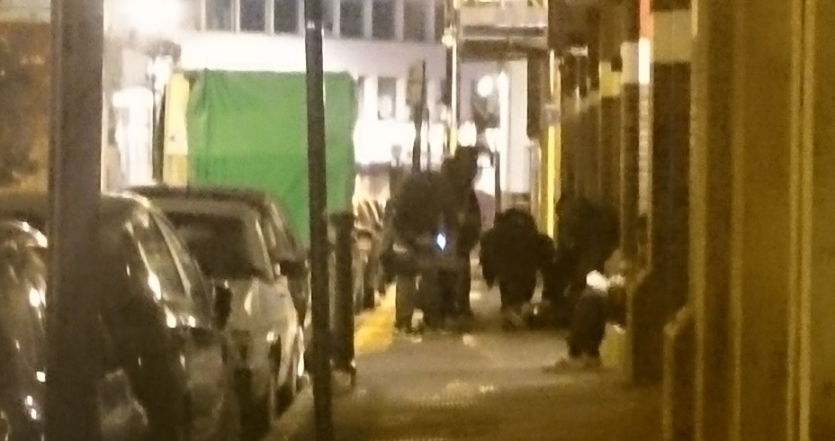
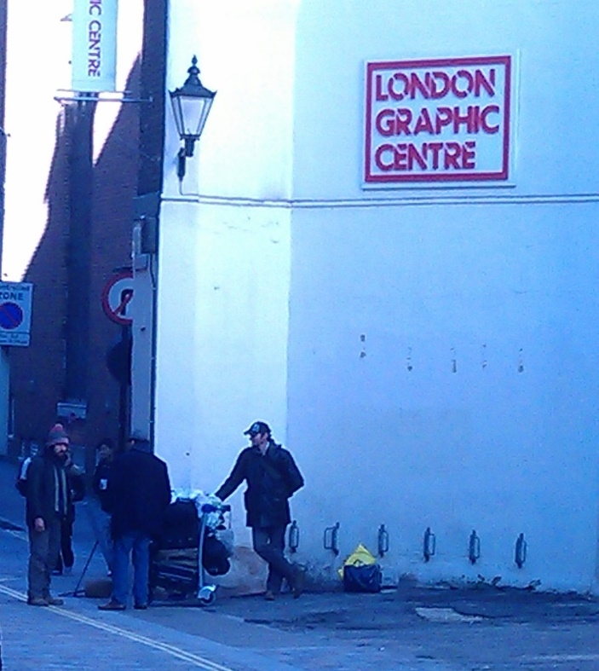
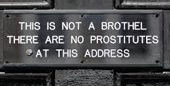

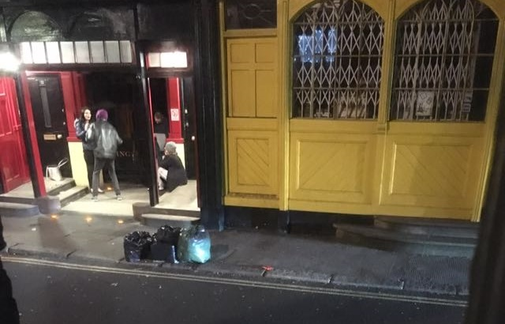
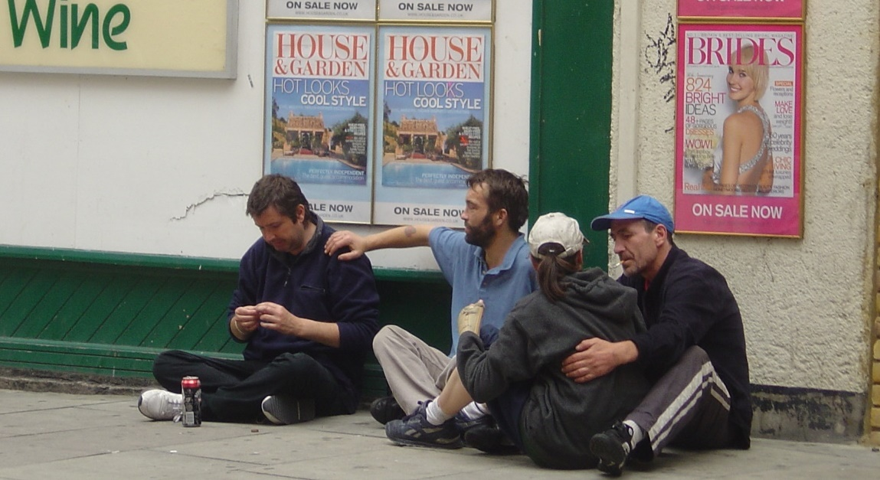
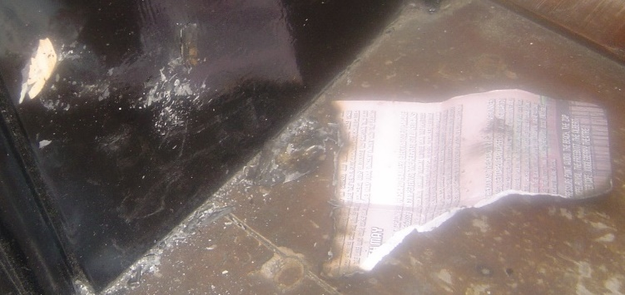
No enforcement
The Authorities can’t cope.
Every night around the back streets of Covent Garden and Soho residents are afraid to go out or to come back home.

Slide 8
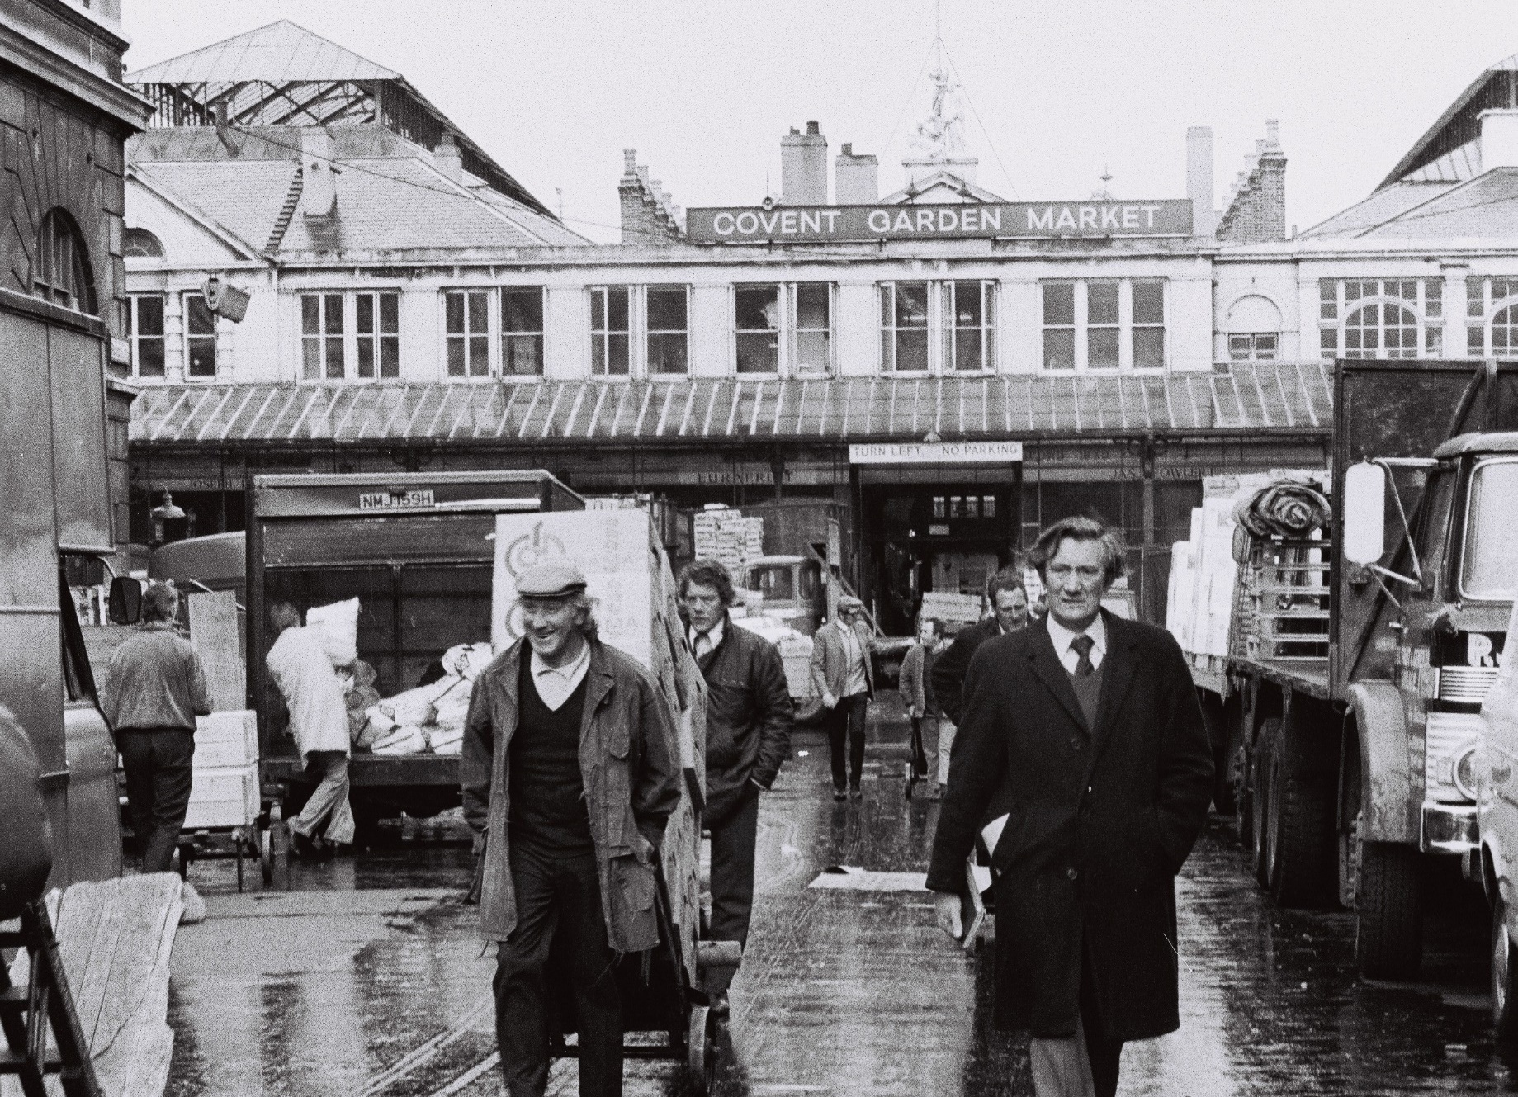
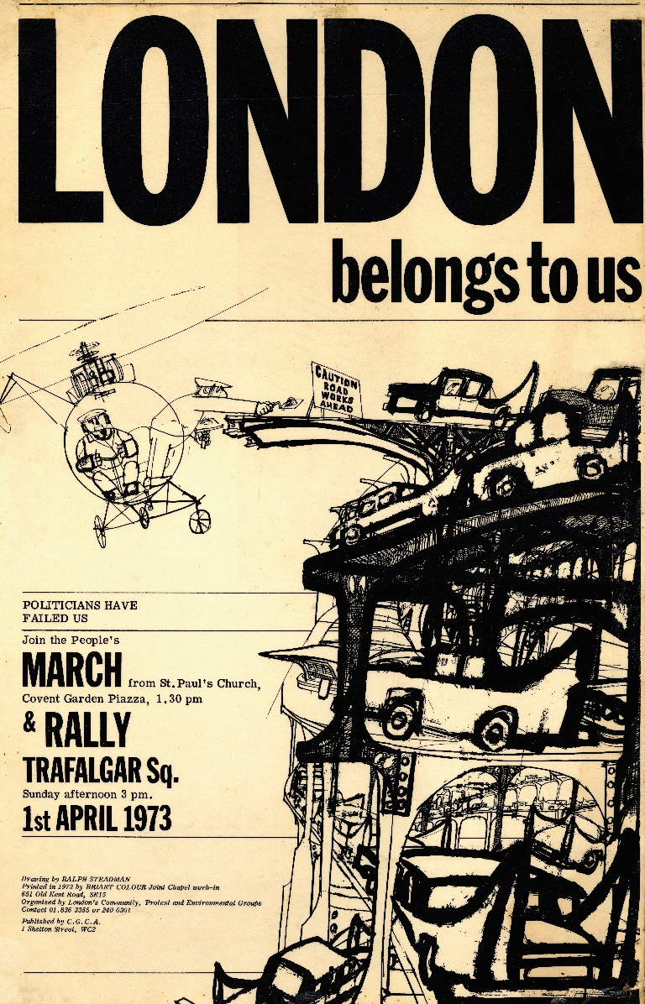
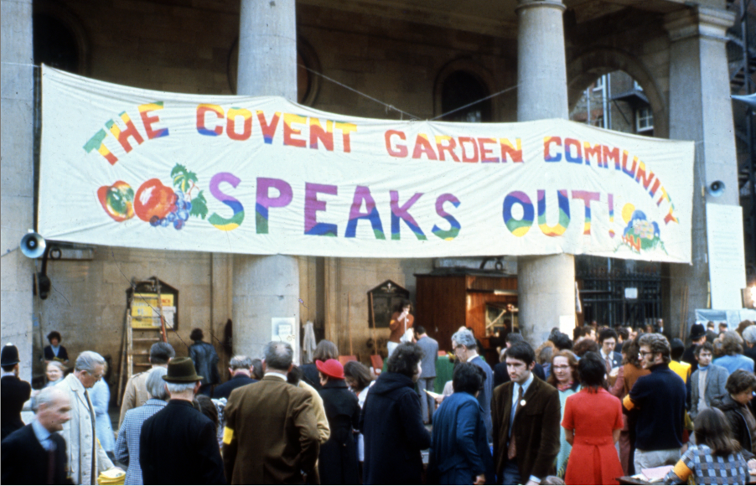

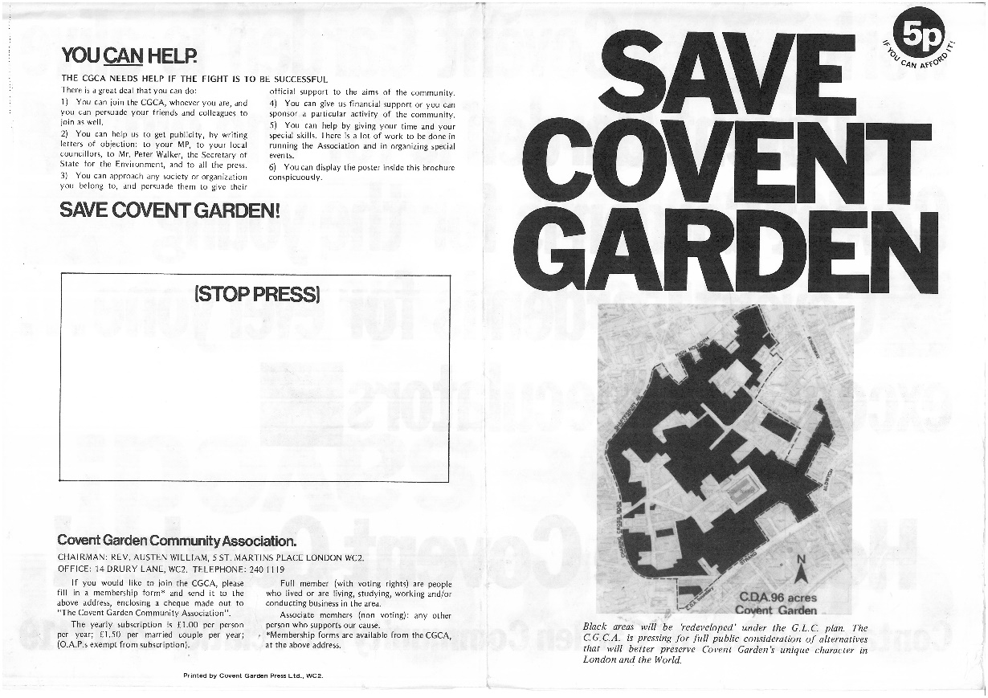
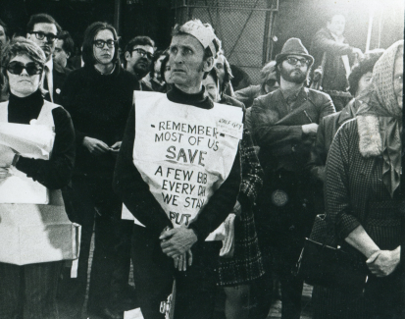
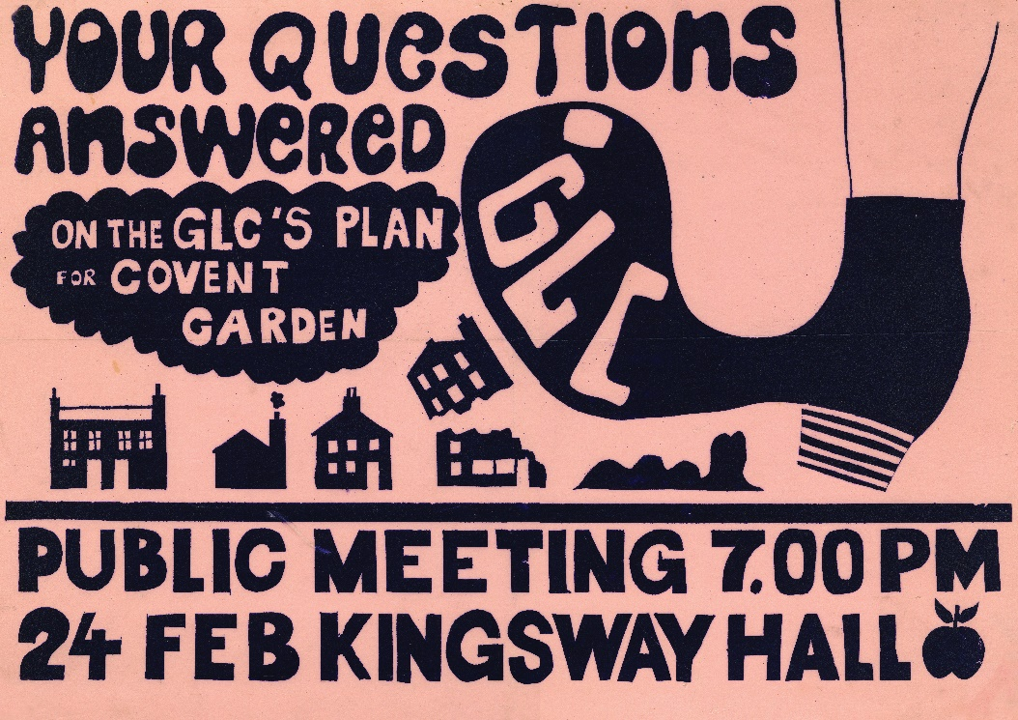
The story of Covent Garden’s post-war housing
The housing of post-war Covent Garden and Soho was won against great odds.

Slide 9
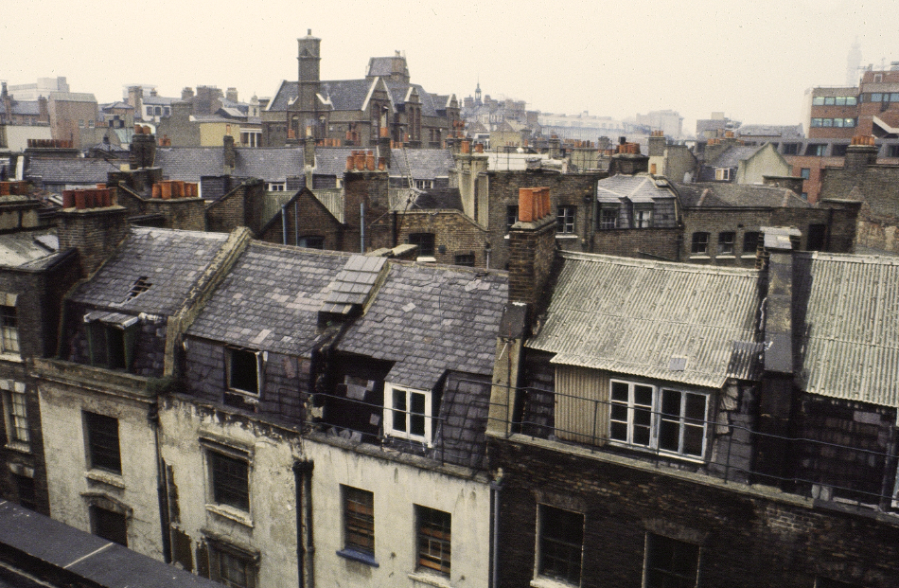
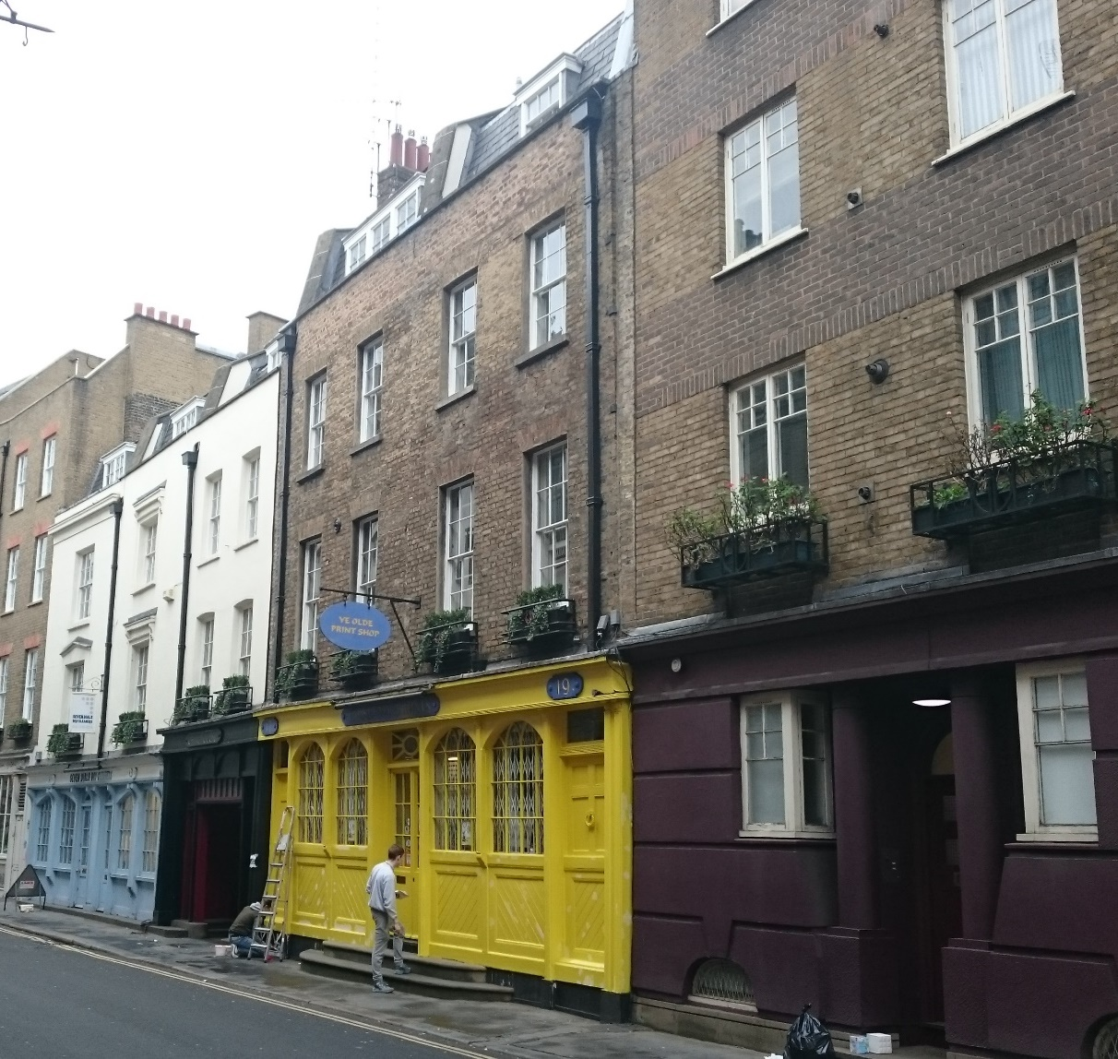
Old dwellings were brought back to life
Old dwellings were brought back to life.

Slide 10
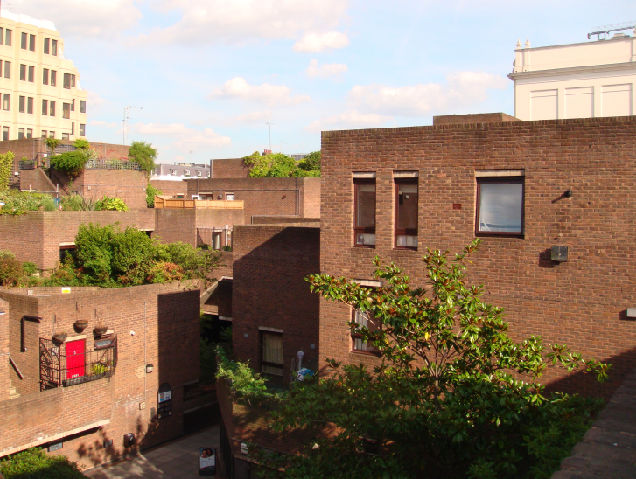
New estates and blocks were built
Many hundreds of new homes were built.

Slide 11

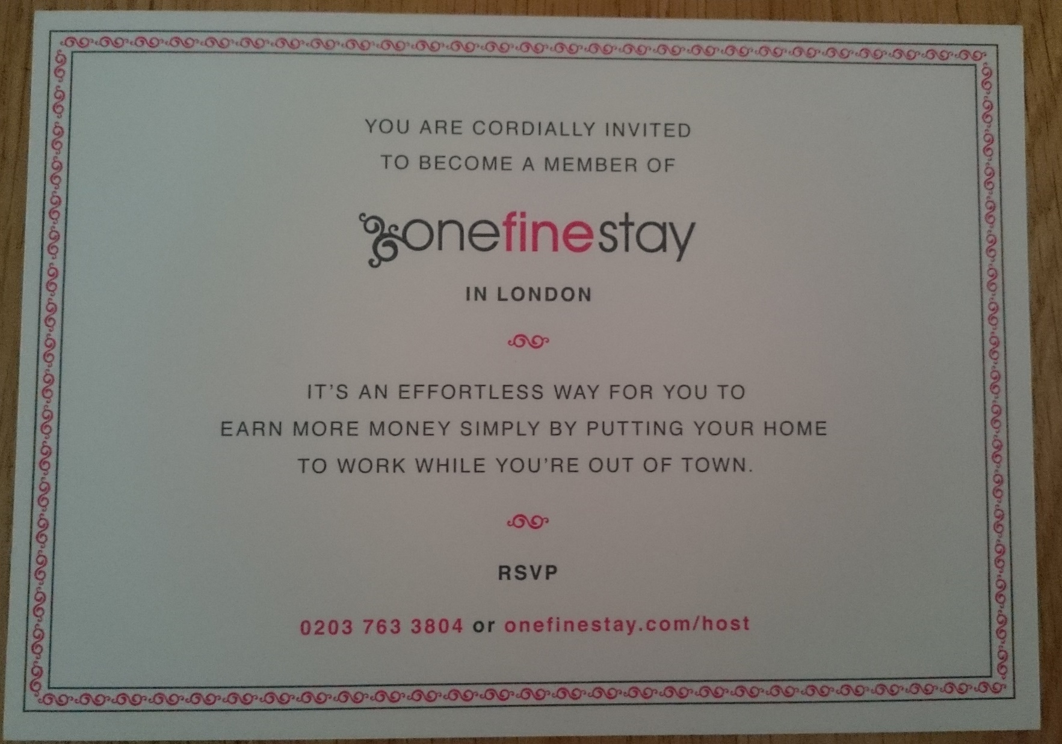




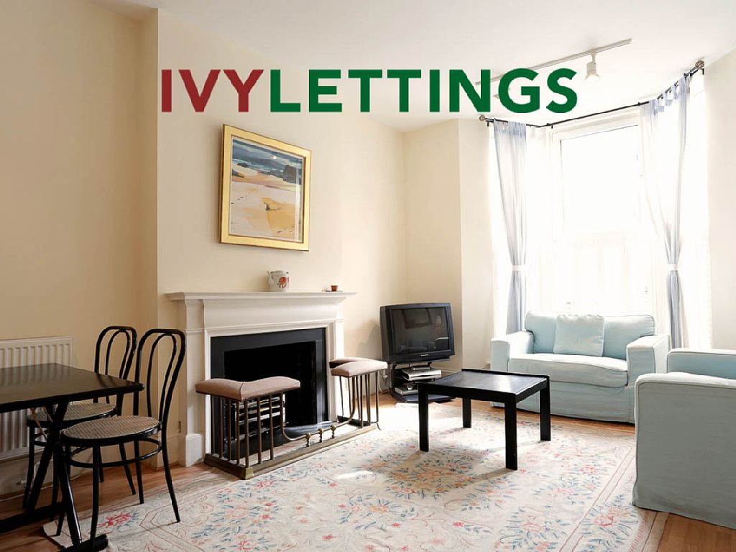
Holiday letting: People started getting leaflets and letters from platforms
How did holiday letting introduce itself?

Slide 12
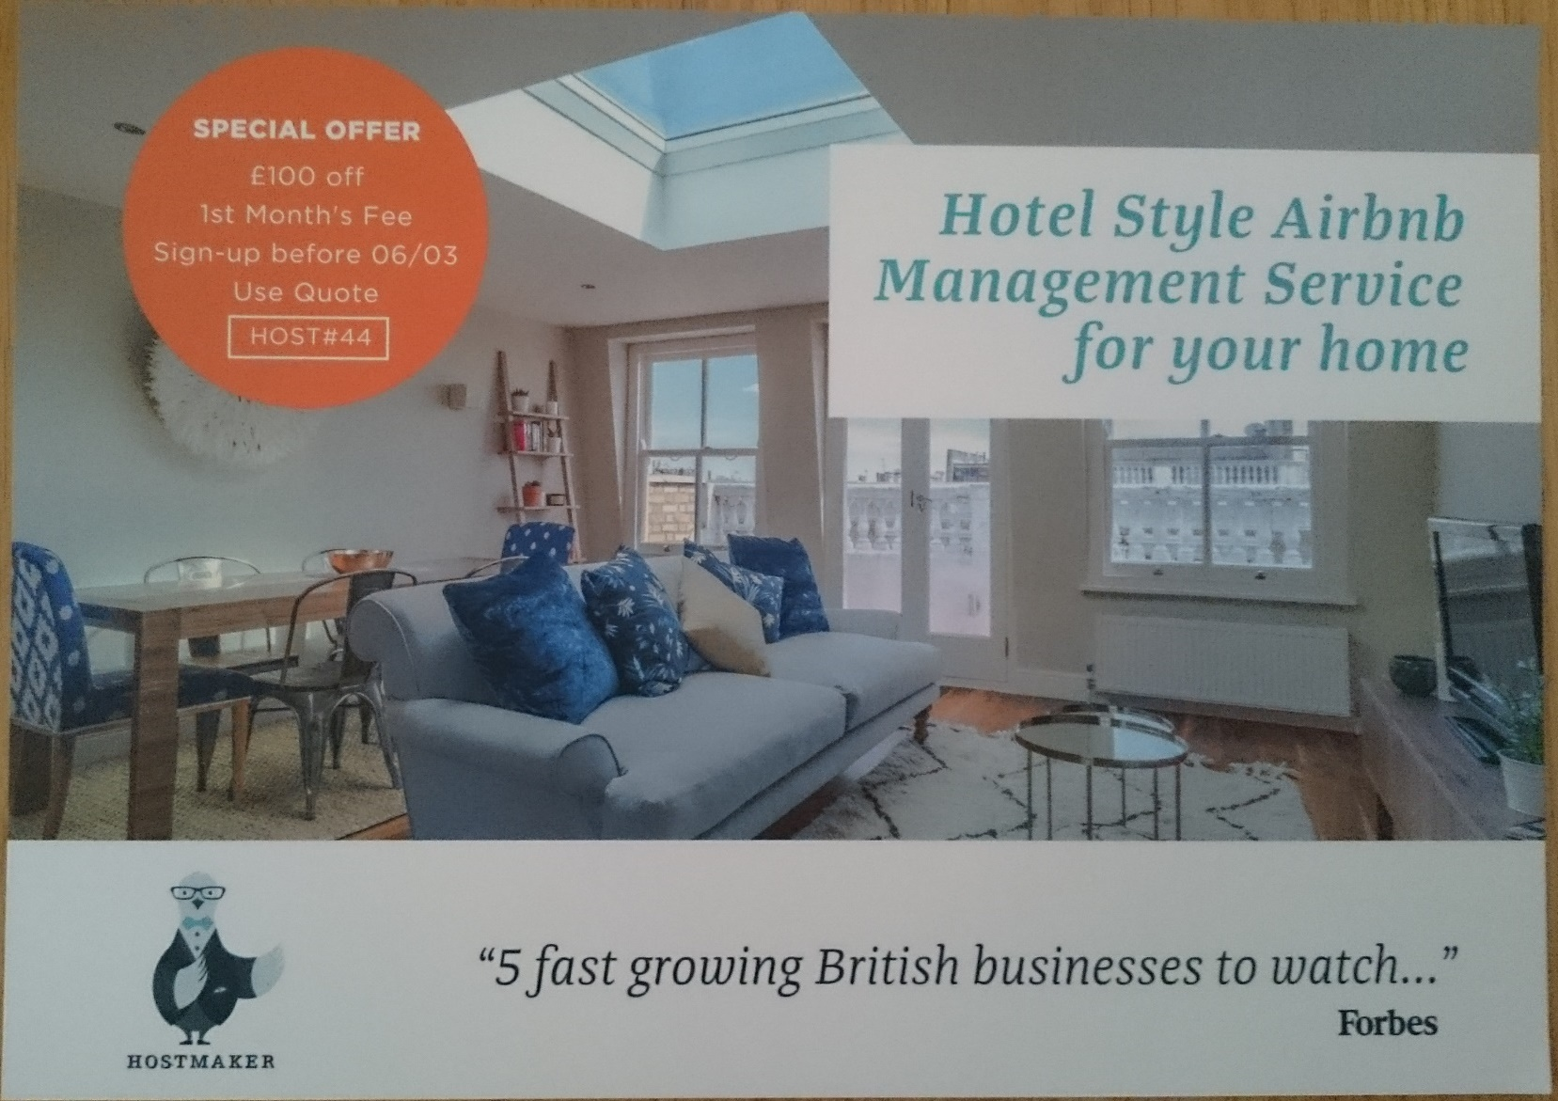



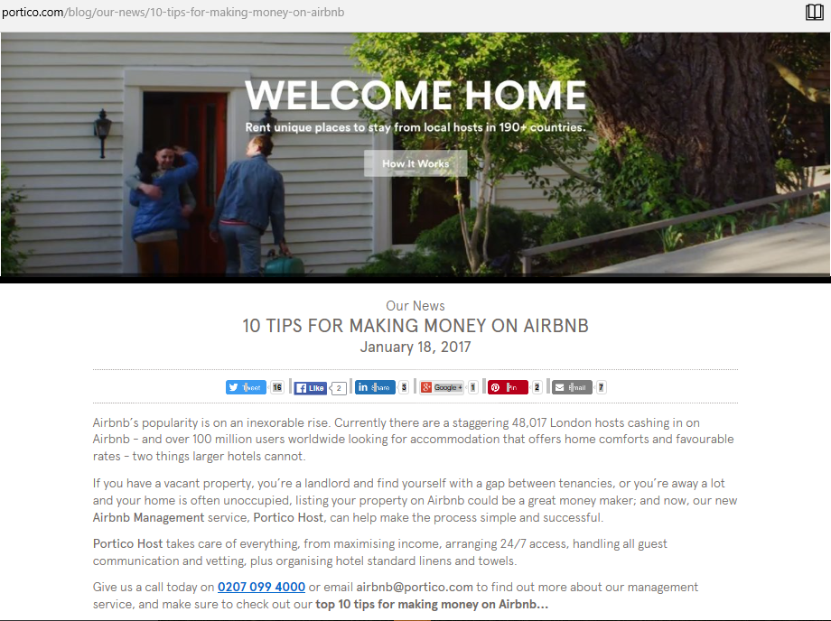


We started getting leaflets and letters and emails from managing agents and student teams
How did we see the industry expanding?

Slide 13
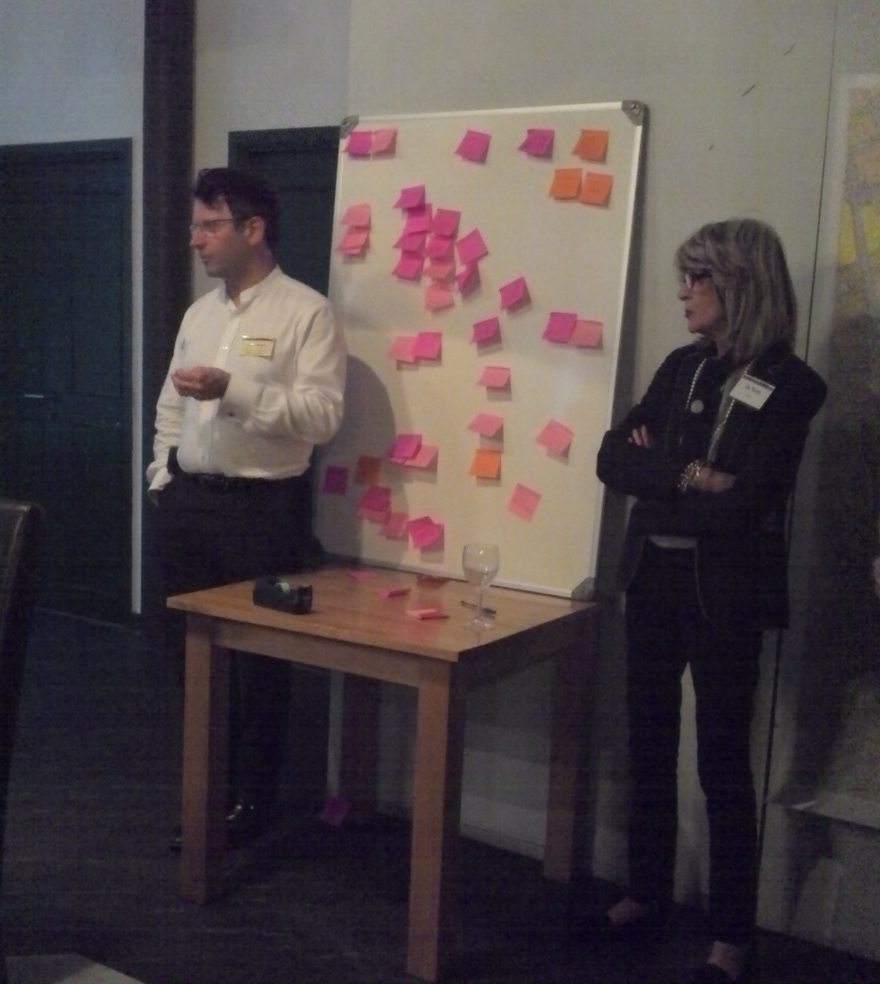
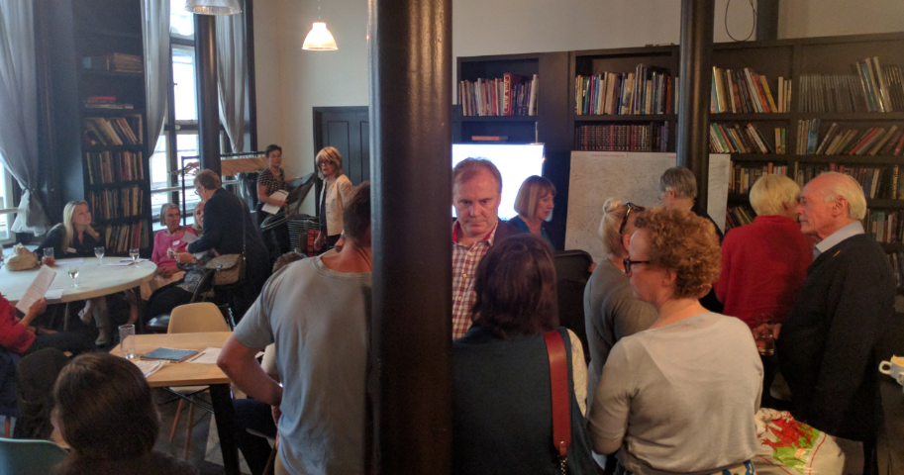
Tenants Association meeting
We held a public meeting in May 2015

Slide 14
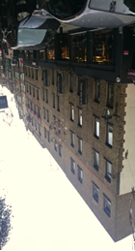
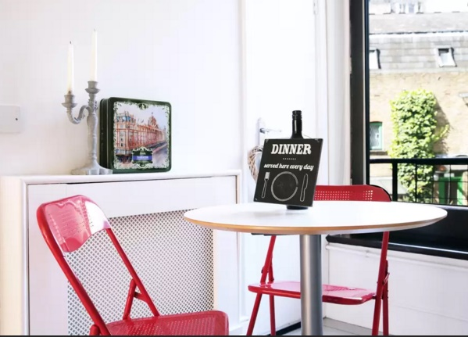
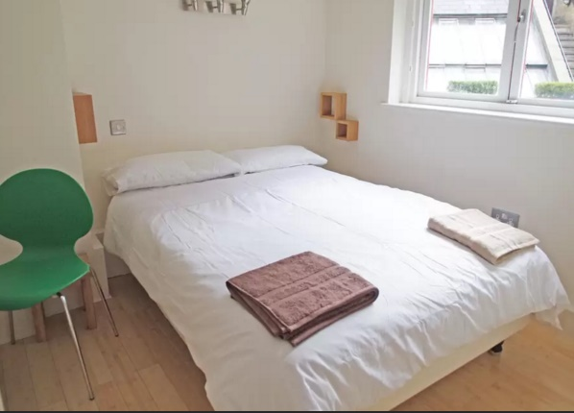
Quote, Seven Dials Court
What residents said
“The owner at number 18 said he was buying the flat to live in it and gave a good story. But we hardly ever see him.
The flat has a lot of people coming and going. And it’s not the only one.
We used to be a really friendly building, but I no longer have the energy to make the effort with all these people. I don’t even bother to say good morning to them any more; they are only here for a night or two.
It has really spoiled the atmosphere. I never thought that I’d say this, but I don’t know if we will stay in Covent Garden now.”
- Owner-occupier for the last 20 years in block of 24 flats, of which at least 3 are used solely for holiday lets.
2 of 5

Slide 15
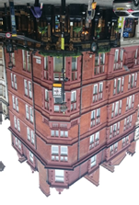

Quote, Charing Cross mansions
What residents said
“We no longer know who should be coming in and who shouldn’t. They come in all the time with big bags. They could be anybody. You just don’t know.
We have a lot of door breaks because people can’t work the lock. So they smash it.
There are always problems with rubbish. The people doing this employ cleaners who put it out whenever they feel like it.
It’s too hard for the management company to justify serving notice; it’s less trouble to let it go.
It’s strange living here now. We’re quite isolated.”
- Retired couple, resident over 50 years in a mansion block in a busy location, with 54 flats where only 10 households are still long-termers.
1 of 5

Slide 16
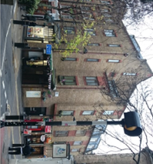
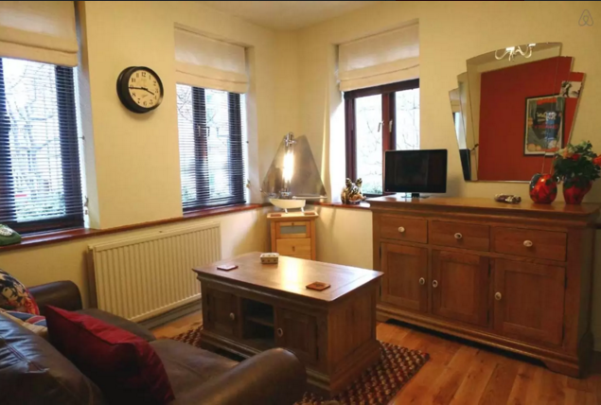
Quote, Nottingham Court
What residents said
“They were really funny about it when I asked if they lived here. I felt awful.
I don’t want to live here anymore. It’s not what it was. It’s not friendly.
I need to know my neighbours to feel safe. And they need to know me.
It is so depressing.
The housing association is useless.”
- Resident for over 30 years, living in a housing association block of 8 flats and large maisonettes, with constant subletting and at least 1 flat used solely for holiday lets.
4 of 5

Slide 17
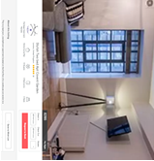

Quote, 25 Shelton Street
What residents said
“Most of our building seems to be short lets. But nobody seems to care or do anything.
We can’t stretch to buying another bedroom in Covent Garden, so with a third child on the way we are going to have to move out.”
- City solicitor with 2 children, owner occupier for the last 8 years in block of 14 flats, of which only 2 are owner-occupied long term. At least 3 were used solely for holiday lets in 2015. In 2017 its 9 or 10.
3 of 5

Slide 18
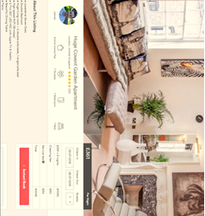
Quote, Ching Court
What residents said
“It took us a year to get to the bottom of what was going on in that flat.
It’s a really standard one-bedroom place and it was being offered for 7 people.
It caused constant disturbance.”
“The last straw was a stag night in the Summer with 20 drunken guys playing the piano and hanging out of the window at Midnight.
Fortunately the local security guards were willing to come and ask them to show some respect, but they didn’t have to.”
- Two sets of owner-occupiers, for 22 and 15 years, living next to a 6 flat conversion.
5 of 5

Slide 19
The problems
Summary of the issues.
Insecurity – now a widespread and serious fear.
Loss of long-term residential property, weakening the community. About 20% of private property in Covent Garden and Soho has been lost in this way.
Upward pressure on rent and property values.
Overcrowding.
Damage to property, noise and nuisance.
Friction with neighbours.
Easy to use homes as party venues and brothels.
None of the usual safety checks.
Wear and tear on the private and public infrastructure with little tax revenue to pay for it.

Slide 20
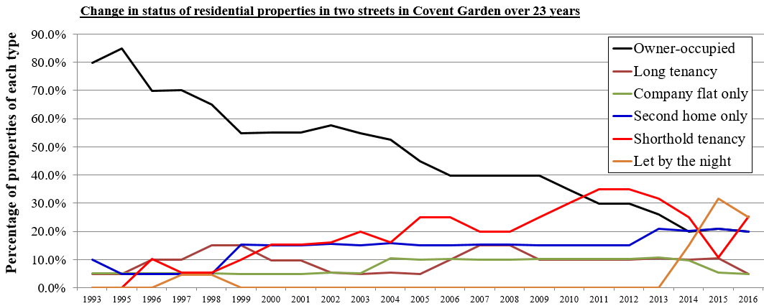
Graph
How changes in our streets are changing our community.

Slide 21
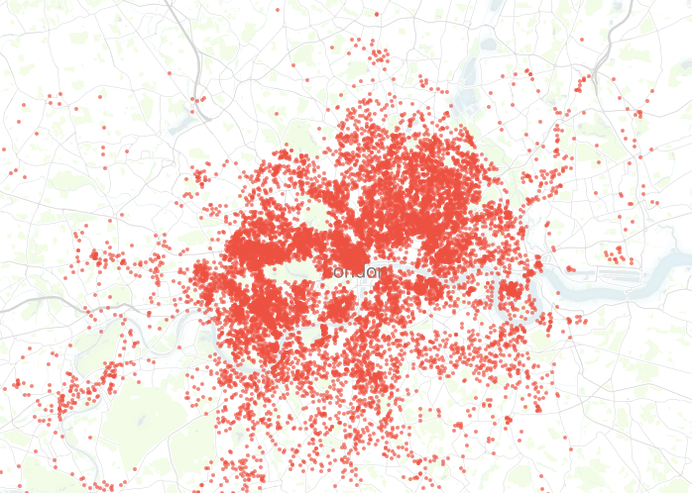
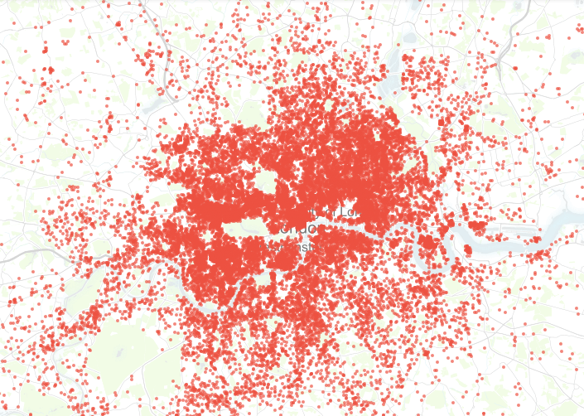
London lets mapped
London’s homes listed on Airbnb alone.
Stoke Newington
http://insideairbnb.com/london-2017-02-06
Westminster
South Camden
Hammersmith
Barking
Richmond
Isle of Dogs
February 2017
November 2015
53,000 listings. 15 months ago there were 26,000.
Half are ‘entire homes’. And half those are available most of the time.
40% are with hosts who offer multiple properties.

Slide 22
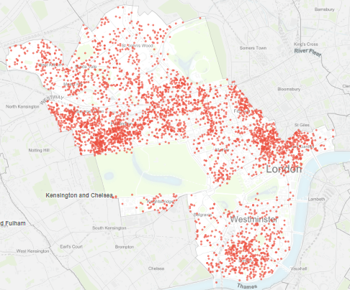
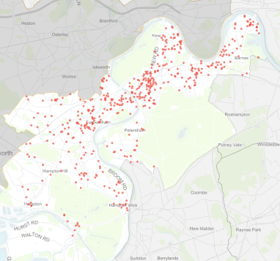

Central London lets mapped
Central London’s homes listed on Airbnb.
Densely built-up Westminster has >5,000 properties listed. 15 months ago it was 3,000.
60% are ‘entire homes’, of which
60% are available most of the time.
10% of the UK total.
15 months ago it was 8%.
Richmond has 470 ‘entire homes’ listed
(was 100).
Barking & Dagenham has only 37 ‘entire homes’ listed (was 4).

Slide 23
Why current legislation fails
Why doesn’t the current legislation work?
It doesn’t deal with security and safety issues.
It doesn’t provide a deterrent. The burden of proof to show >90 days is too onerous. Enforcement is too lengthy.
AVAILABILITY is what matters to communities, not days let.
A blanket exclusion would penalise legitimate householders.
The business model works at low occupancy in expensive areas.
The business has anti-competitive tax advantages.
Even those who should pay tax are not incentivised to declare income.
Neighbours have nowhere to turn: the police, freeholders and local authorities cannot deal with problems.

Slide 24
Possible solutions
What might work?
1. A simple licensing system for booking platforms, with transparency.
Pay a levy as a fair cost of doing business. Ring-fenced to fund industry management, safety checks, a 24/7 callout service + a community contribution. Still much less than hotels pay in VAT!
Carry out ID checks and other security measures (full service platforms already do). Provide full building insurance.
Centralise booking data with all licensed platforms.
Provide end of tax year income statements to landlords, available to HMRC.
Exterior photos.
2. A light-touch registration system for landlords letting entire homes.
Notify the local authority, with only primary residences allowed.
Register tax reference with platform.
3. Changes to tax legislation.
Remove tax-free income allowance for letting entire homes.
Widen of scope of VAT.

Slide 25
Residents’ groups
We know our neighbourhoods. Please listen to us.
West End Community Network
Bloomsbury Association
Charlotte Street Association
Covent Garden Community Assoc.
Fitzrovia Neighbourhood Association
Leicester Square Association
Marylebone Association
Mayfair Residents Group
Soho Society
Residents' Soc. of Mayfair & St James
Covent Garden Area Trust
Seven Dials Trust
Westminster Amenity Societies Forum
(those in WECN not listed twice)
Bayswater Residents Association
Belgravia Residents Association
Harrowby and District Residents Assoc.
Hyde Park Estate Association
Knightsbridge Association
North Paddington Society
Paddington Waterways and Maida Vale S.
Queen's Park Estate Society
St. John's Wood Society
St. Marylebone Society
South East Bayswater Residents Assoc.
Thorney Island Society
Westbourne Neighbourhood Association
Westminster Society
Marylebone Association
+ the London Forum of
Amenity and Civic Societies.

